Slide 1
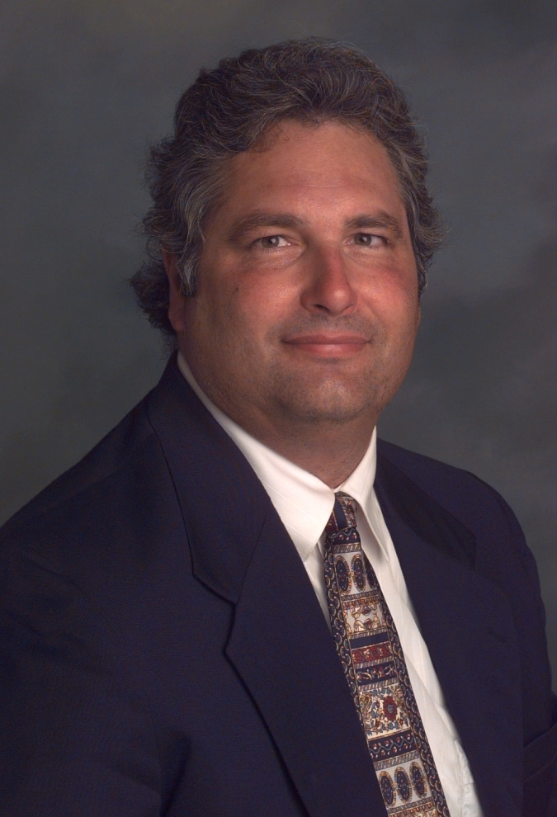
Data Science in L.A.'s “Silicon Beach”: Shadow Vocation or Emergent Profession?
2015 CSU-POM Conference
CSU Northridge
Saturday, February 28, 2015
Wayne Smith, Ph.D.
Department of Management
CSU Northridge
ws@csun.edu
This presentation is available at:
smithw.org/csupom.pdf or github.com/wsphd/csupom/

Slide 2
Motivation
Background/Preliminaries
I apologize…
“cloud computing”, “big data”, “[xyz] analytics”, and worst of all, “data science”
These are industry buzz “terms”, not our terms.
I prefer decision-support systems, predictive modeling, statistical computing, and mathematical optimization, but most of the folks I routinely work with prefer the term “data science” (We might agree on the terms reproducible, analytics and visualization).
I am on the steering committee for the LA R/Data science Meetup group
There are a few other Ph.D.s heavily involved too—Szilard Pafka (primary lead), David McArthur, Rob Gould, Jeremy Miles, Tim Triche, Eduardo Arino de la Rubia, and others
“Data as the New Oil” Opportunities and Challenges
Is there a perturbation (disequilibrium) in this labor market?
Exactly what is the production, operations, transportation, logistics of bits viz. atoms?
What is our institutional role (if any) in this (increasingly, non-college) community?
Are we witnessing the emergence of a new data guild in the modern service economy?

Slide 3
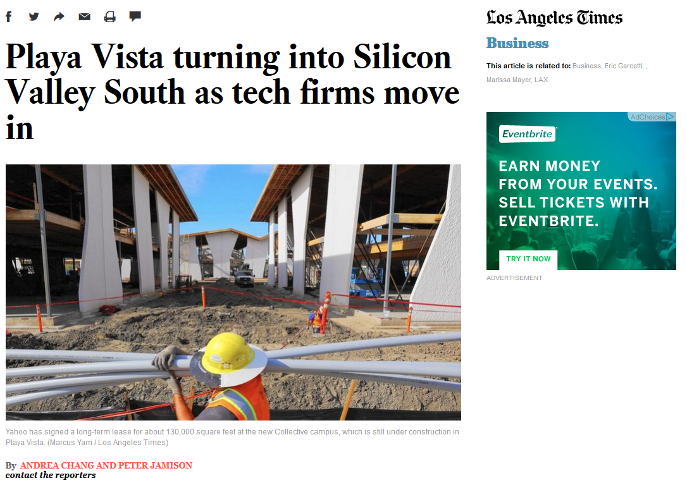
http://www.latimes.com/business/la-fi-silicon-valley-south-20150118-story.html#page=1

Slide 4
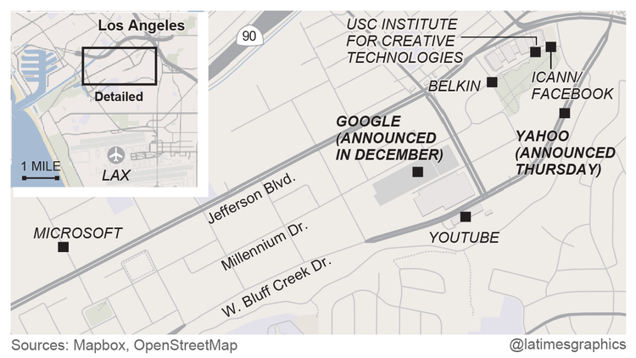

Slide 5
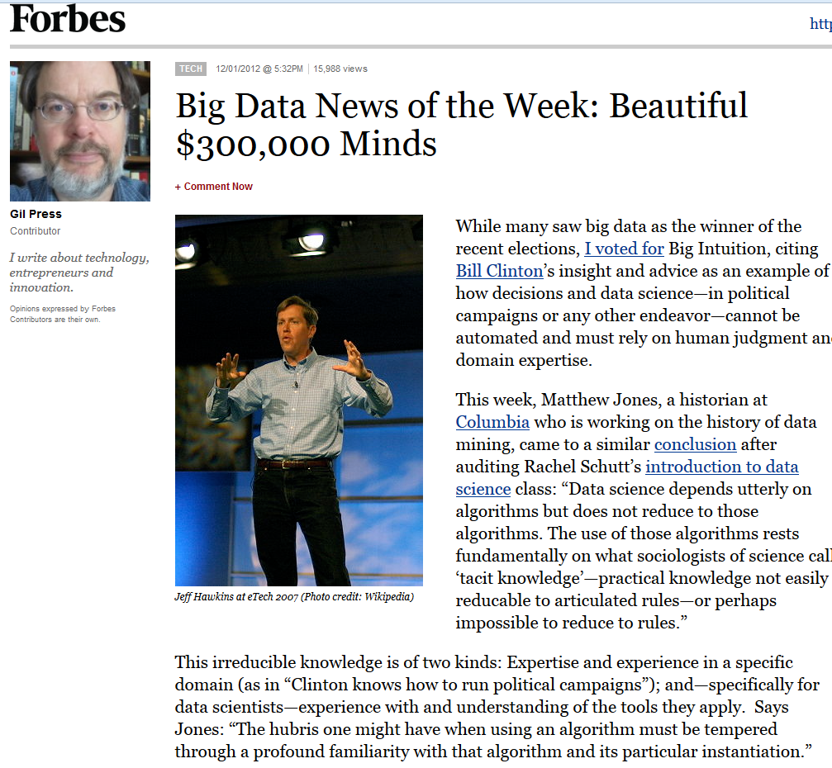

Slide 6
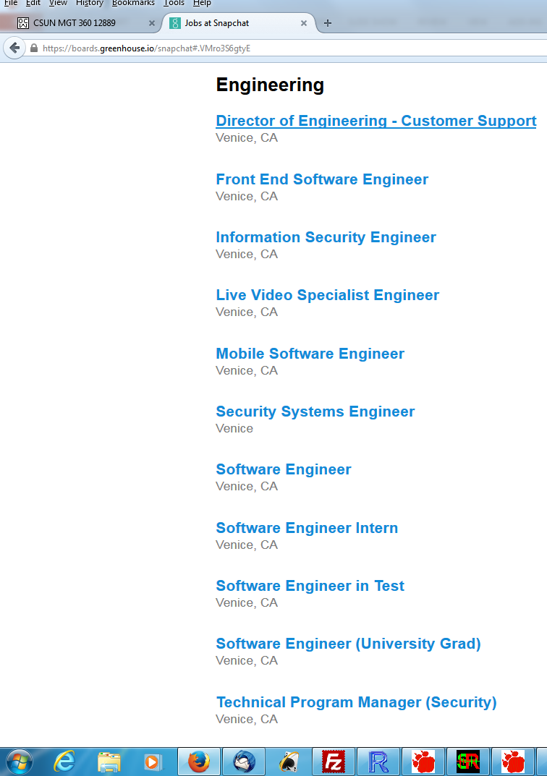

Slide 7
R and/or other tools
COTS (Non-FOSS)
SAS, IBM SPSS, Stata, S-PLUS, BMDP, Lisrel, EQS, HLM, MPLUS, SmartPLS, …
Mathematica, @Risk/Excel add-ins, RATS, Matlab, Simscript, Arena, etc.
IBM Netezza, MS Anal. Serv., Oracle Adv. Anal., SAP HANA, Teradata Miner, etc.
UCINET/NVivo/Tropes, ConQuest, ArcGIS, AutoDesk, etc.
IBM CPLEX, MOSEK, GUROBI, Frontline, etc.
FOSS/GNU
Domain-specific?
GRETL/xBUGS, Ggobi, Pajek, lisp-stat, Netlib/BLAS/LAPACK/FFTPACK, etc.
Sage, Octave, Scilab, Java/Colt/JFreeCharts, incanter, Protovis, D3, etc.
GNU LP, COIN-OR, NASTRAN/BLAS, NETLIB, WordNet, statconn, etc.
General-purpose?
jQuery/jqueryUI/flot/jstat, BIRT, RapidMiner, Pentaho, MongoDB, etc.
Apache Hadoop/Spark/Solr/CouchDB/Lucene/OpenNLP/Mahout/Velocity, etc.
Python ― iPython/NumPy/matplotlib/statmodels/Blaze/Bokeh/scikit-learn, etc.
Julia ― iJulia/Juno/MultivariateStats/MLBase/TimeSeries/Gadfly/JuMP, etc.

Slide 8
Coordination
Monthly Meetups (physical, not virtual)
E.g., www.datascience.la
Monthly meetings (50-200 people)
By language/platform/environment: R, Python
By technology/workflow: Visualization, DW/BI, Machine Learning
By sector/domain: AdTech, FinTech
By management “level”: a few directors- and mangers-only events (by invitation only)
Annual Conferences (physical, not virtual)
E.g., “Big Data camp” at Direct TV (El Segundo)
http://insidebigdata.com/2014/06/03/free-conference-big-data-camp-2014/
Multiple, parallel tracks
Vendor support (all expenses covered fully)
Last three years’ attendance—200 (2013), 500 (2014), 800 expected (2015)

Slide 9
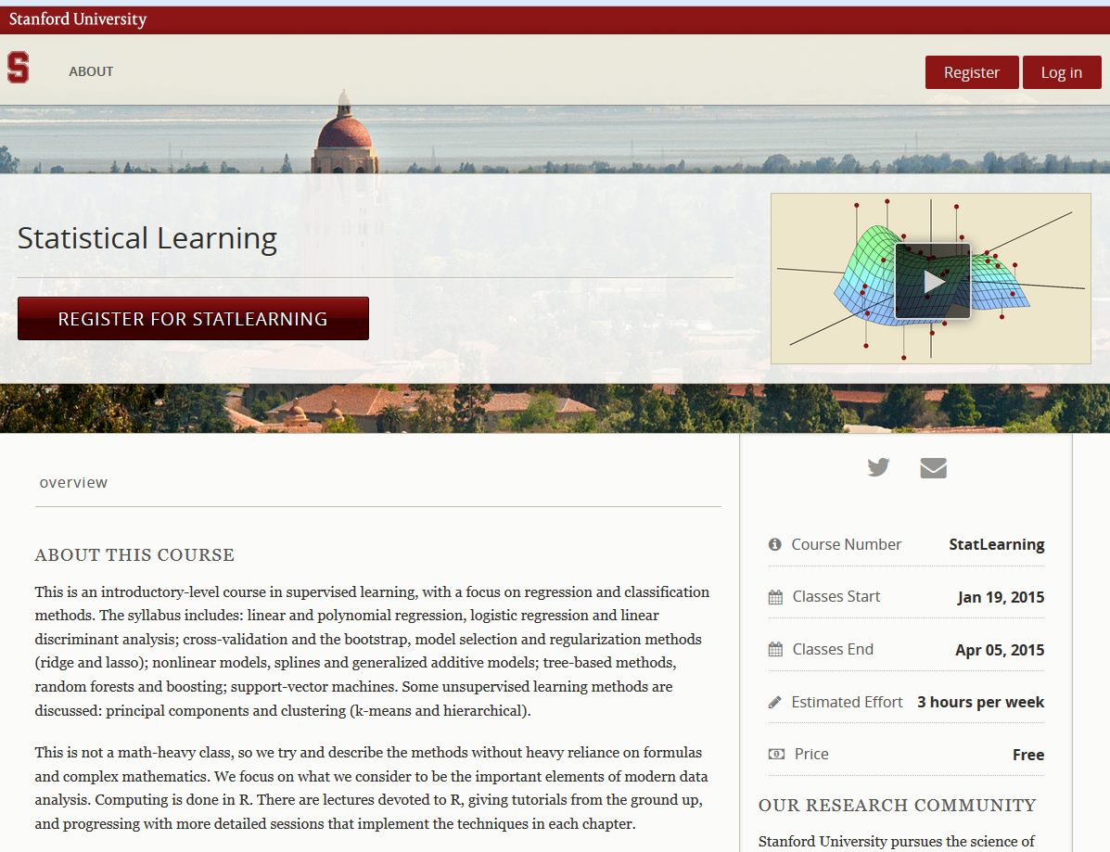

Slide 10
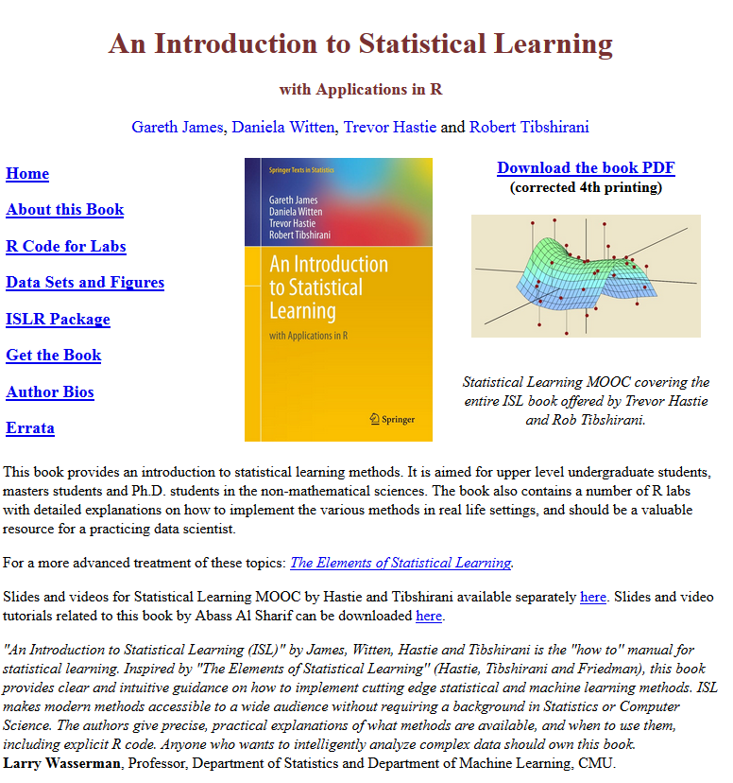

Slide 11
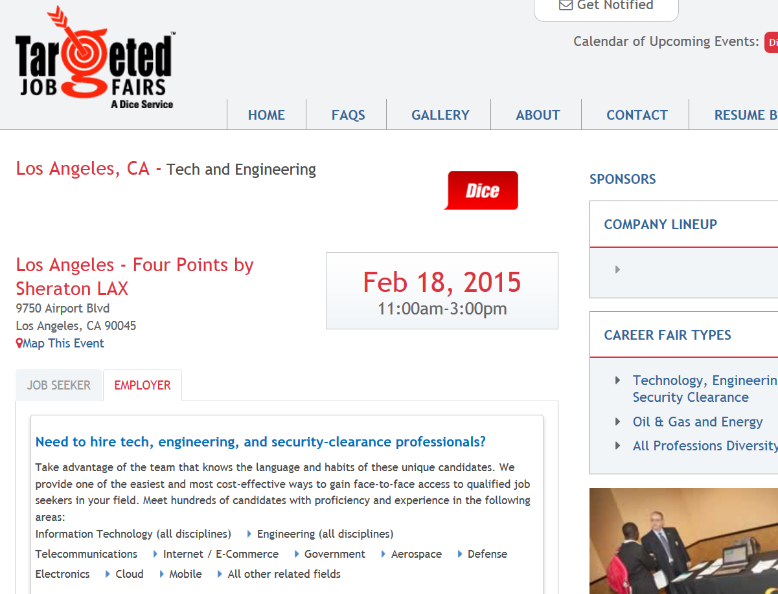

Slide 12
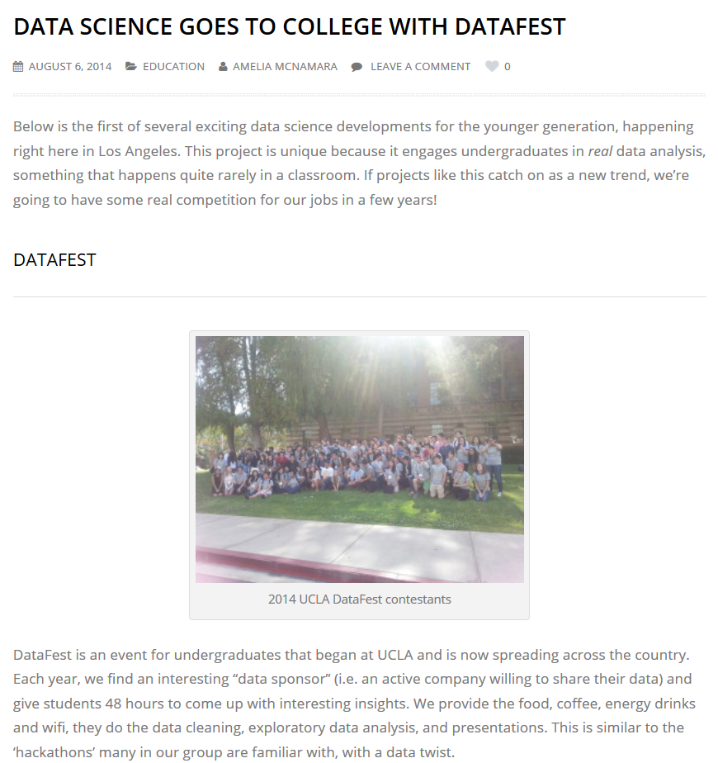

Slide 13
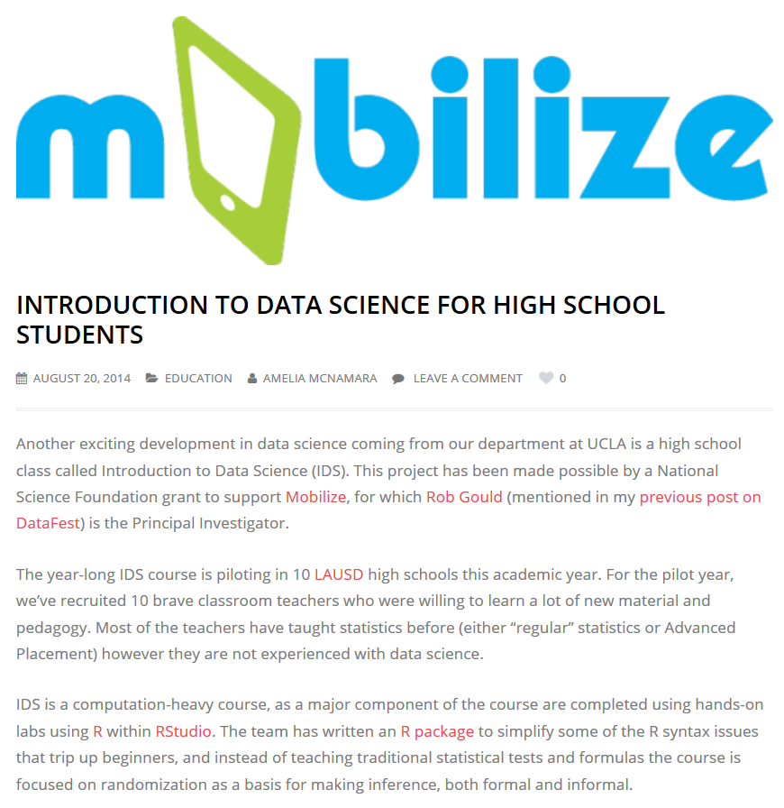

Slide 14
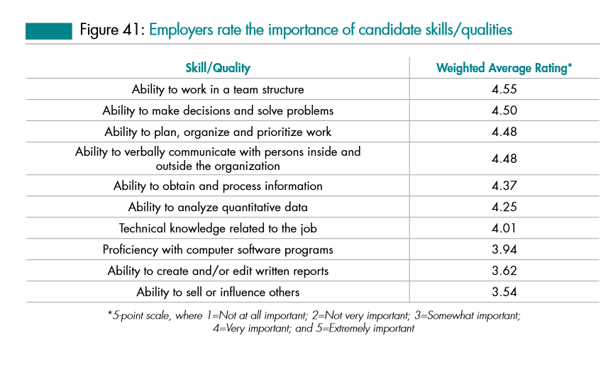
Relative importance of “data science”
Source: Job Outlook 2014, National Association of College and Employers

Slide 15
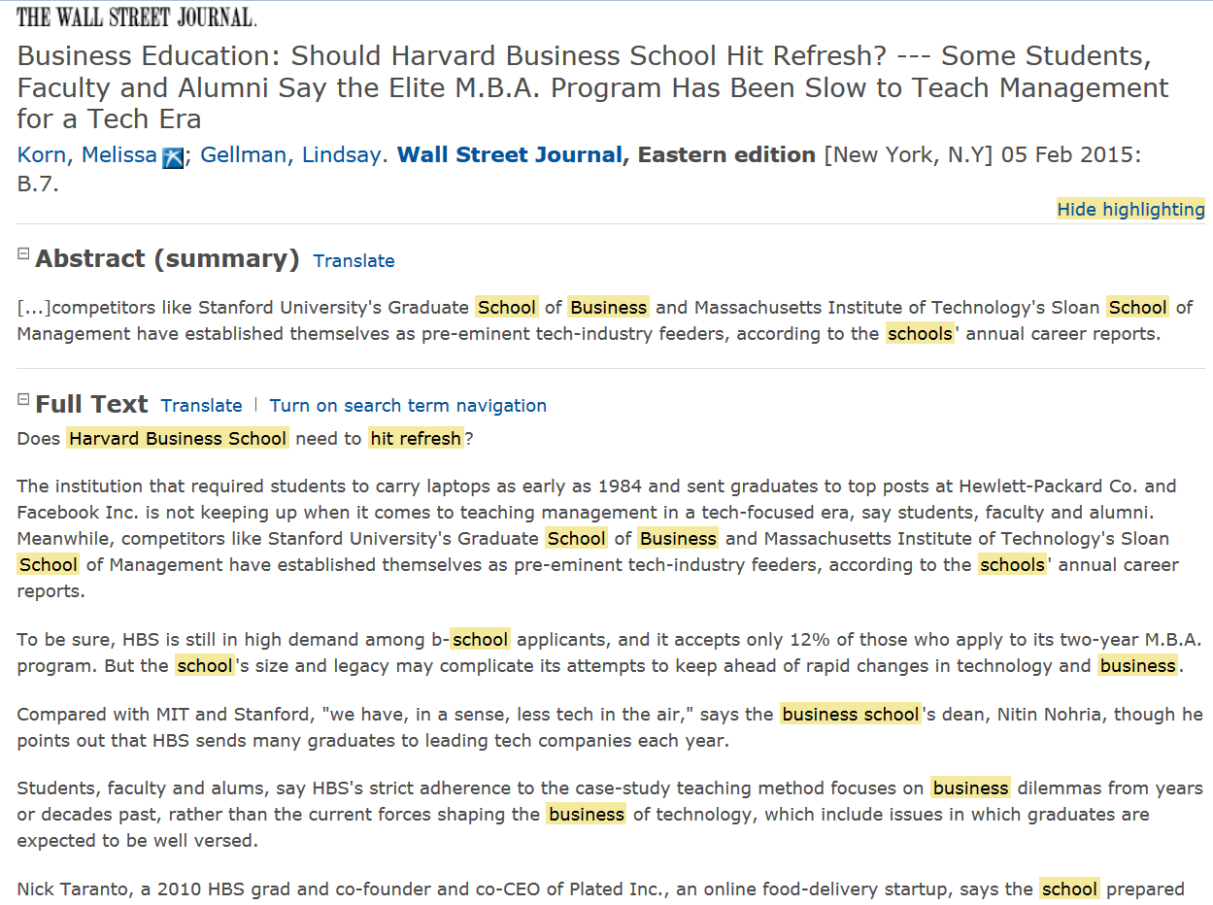

Slide 16
4-year Schools in this New “Service” Economy in CA?
USC, M.S. (part of the C.S. Dept.)
http://www.cs.usc.edu/academics/masters/msdata.htm
UCI Extension, certificate
http://unex.uci.edu/areas/it/data_science/
UC Berkeley, M.S. (online) (part of the School of Information)
http://datascience.berkeley.edu/
CSU Fullerton, certificate, online, accelerated
http://extension.fullerton.edu/professionaldevelopment/certificates/data-science
Near Fails:
UCOnline – Outside investors want the students, faculty, and curriculum, but not the bureaucracy.
CSUOnline – Severe misunderstanding of the elasticity of demand for this service catchment group.
Is CSU (mainstream) appropriate? Cross-disciplinary? Other approaches/ideas?

Slide 17
CCC’s in this New “Service” Economy?
15 CA Community Colleges will offer Bachelor’s Degrees beginning in 2017.
Airframe manufacturing technology, Antelope Valley College
Industrial automation, Bakersfield College
Emergency services and allied health systems, Crafton Hills College
Mortuary science, Cypress College
Equine industry, Feather River College
Dental hygiene, Foothill College and West Los Angeles College
Bio-manufacturing, Mira Costa College
Respiratory care, Modesto Junior College and Skyline College
Automotive technology, Rio Hondo College
Health information management, Mesa College
Occupational studies, Santa Ana College
Interaction design, Santa Monica College
Health information management, Shasta College

Slide 18
Candidate Explanations (1/3) (Technological)
Neo-Classical Economics
Supply and Demand
“There is a shortage of individuals with “data scientist” skills; I can exploit that market disjunction.”
Empirical Finance
Loan-to-Value
“I might not achieve my potential, but at least I’m not in debt.”
Statistics (stochastic inference)
Privilege specification (narrow, overfitted results) over generalization (broader theory development)
“If I have more data, then I believe that I will have proportionally more information.”
Computer Science (machine learning)
Demonstrated capability with the current (“right now”) platforms and languages is the valued skill.
“I need computationally-intensive and unsupervised (no response var.) approaches for “big data”.
Information Systems
Data management; data “wrangling”; Complex SQL Joins; rectangular transformations; file I/O
“The difficult data queries all come through me anyway; I’ll might as well just do the analysis too.”

Slide 19
Candidate Explanations (2/3) (Sociological)
Psychology
Ego-centrism, absolutism, and perhaps, nihilism
“You don’t know me! Universities mostly just teach theories and I mostly just write papers.”
Sociology
Exponential Random Graph Models (agent- and ego-networks)
“I just need to immerse myself in the right industry, organizational, and community eco-system.”
Cognitive Science
Visualization is the new Descriptive Statistics
“Don’t use messy assumptions, models, and inference; just display high-dimensional graphs.”
Political Science
Rational Choice theory (perceived minimal efficacy in structural, government change); Elite theory
“If I don’t take this job, someone with an H1-B Visa might; besides I want power through my skills.”
Higher Education
Just-in-time training (short-term, practical) is different than just-in-case education (life, holistic).
“I want shallow, just-in-time theories for my practice (to answer the boss’ questions next week).”
K-12 Education
Autodidactism, Self-directed learning
“Technology is ubiquitous; I can learn from Linux, Raspberry Pi, Arduino projects, and 3D printing.”

Slide 20
Candidate Explanations (3/3) (Other/Interdisciplinary)
Behavioral Economics
Extreme Discounting
“I am deliberately overweighting short-term preferences and underweighting long-term goals.”
History
Merchant-Craftsmen (some land) and Craft Guilds (no-land) (apprentice → journeyman → master)
“Trades[men] and crafts[men] have always created local, persistent, supportive communities.”

Slide 21
Open Questions
Is this observation an itinerant, ephemeral fad or a persistent structure?
Is this eco-system geographic-specific or due to its virtual nature, widespread?
Vis-à-vis other paid work, is this type of work off-shorable over time?
If this sector is indeed growing, is it still just a small part of the economy anyway?
Is this phenomenon (like some other aspects of IT) gender-skewed?
Does the evidence suggest privileging competencies over degrees?
Is my experience with these “professionals”, ultimately, the triumph of practice over theory (as seen from the perspective of a prospective, potentially confused soon-to-be-in-some-debt-from-a-student-loan CSU student)?

Slide 22
Open Questions
Without college degrees, how will these “data scientists” eventually lead/be ethical/well-rounded, etc. over a 40-year career arc?
What about Licensing? Certifications? CPE? “Badges”?
How will they get promoted? Corollary: How, if ever, will the model building get more rigorous?
Can they can just enroll into holistic B.S./B.A. (pre-M.S./M.B.A.) programs later in life?
If applied math, computer science, statistics, and business were all individual degrees before, then how could we possibly make a single “data science” degree (all of them together) now?
What is the role of Ph.D.’s and academics (other than paid consulting)?
If we help (e.g., lectures, provide experts, networking, etc.), are we, in fact, directly or inadvertently helping young folks not go to College?
What do we tell our Deans and Provosts about our deep involvement with individuals who able-but-unwilling to (traditional, B.A./B.S.) college?
Isn’t this phenomenon, if evident, just a new version of (yet one more) vocation?
The CSU, as one component of the CA Master Plan, doesn’t “train” individuals (non-professionals) into vocations. We “educate” individuals for broader success.
Does any of this matter to our programs in either the short-run or long-run?
Your thoughts?

Slide 23
Further Reading (peer reviewed)
Brynjolffson, E., Hitt, L. M., and Kim H. H. (April, 2011), Strength in Numbers: How does data-driven decision-making affect firm performance? (working paper) [ http://ssrn.com/abstract=1819486 ]
Finzer, W. (2013) , “The Data Science Dilemma”, Technology Innovations in Statistics Education, 7(2) [ https://escholarship.org/uc/item/7gv0q9dc ]
Hardin, J., Hoerl, R., Horton, N., and Nolan, D. (Oct. 12, 2014), Data Science in the Statistics Curricula : Preparing Students to “Think with Data” [ http://arxiv.org/ftp/arxiv/papers/1410/1410.3127.pdf ]
Horton, N., Baumer, B., and Wickham, H. (Feb. 1, 2015) , “Setting the stage for data science: integration of data management skills in introductory and second courses in statistics” [ http://arxiv.org/pdf/1502.00318.pdf ]
Tambe, P. (April, 2011), Big Data Investment, Skills, and Firm Value, Management Science (pre-print) [ http://papers.ssrn.com/sol3/papers.cfm?abstract_id=2294077 ]

Slide 24
Further Reading (non peer-reviewed)
Davenport, T., and Patil, D. J. (2012), “Data Scientist: The Sexiest Job of the 21st Century”, Harvard Business Review, October.
History of the Organization of Work
http://www.britannica.com/print/topic/648000
Los Angeles Economic Development Corporation
High Tech in LA (October, 2014)
http://laedc.org/wp-content/uploads/2014/10/High-Tech-in-LA_20141006_FF.pdf
McAfee, A., and Brynjolfsson, E. (2012), “Big Data: The Management Revolution”, Harvard Business Review, October.
McKinsey Global Institute Report (Manyika, J. et al.)
Big data: The next frontier for innovation, competition, and productivity (May, 2011)
http://www.mckinsey.com/insights/business_technology/big_data_the_next_frontier_for_innovation

Slide 25
Further Reading (additional references)
Journals:
Journal of Data Science; Data, dikw, big data and data science
Big Data; Machine Learning; Data Mining and Data Discovery
Periodicals
Analytics Magazine (http://www.analytics-magazine.org/)
“Academic” Conferences
INFORMS Big Data conference (April, 2015) (Huntington Beach, CA)
http://meetings2.informs.org/wordpress/analytics2015/
ACM SIGMOD “Management of Data” conf. (May/June, 2015) (Melborne, VIC, AU)
http://www.sigmod2015.org/
ACM KDD “Knowledge Discovery and Data Mining” conf. (Aug, 2015) (Sydney, AU)
http://www.kdd.org/kdd2015/
“Practice” Conferences
TDWI Big Data conference (February, 2015) (Las Vegas, NV)
http://meetings2.informs.org/wordpress/analytics2015/
R Users Conference (June/July, 2015) (Denmark) (2014 was at UCLA)
http://www.r-project.org/useR-2015

